Slide 1

Sentiment Analysis of Song Lyrics
Aparna Raghavendra Rao

Slide 2

Introduction
Motivation behind the project
Objectives and Goals
Background
Key Players

Slide 3
The Motivation
Understand Perception – Understanding the audience’s perception towards a song. Why does a certain tune evoke emotions? Why is our favorite song our favorite song?
Explore Trends – Music is a common language that is spoken by people. Music is often inspired by and impacted by the artist’s thoughts towards a particular issue. But is the audience’s sentiment towards songs impacted by a major event, such as COVID-19?
Informed Decisions – Music producers and artists can gather insights from the data and tailor music so that it does well with their intended target audience.
Data for Music Recommendation Systems – The music suggested to a listener can be customized based on their sentiment towards a particular type of music.

Slide 4
Objectives of the Study
Understand the workings of and the key players in the American Music Industry
Apply sentiment analysis to top Billboard songs between 2019-2023 to understand audience perceptions.
Analyse data to check for a shift in overall sentiment towards songs before and after the COVID-19 pandemic.

Slide 5
Background
1960s – 2000s – Record labels promoted artist’s music. Main medium was the Radio & Television.
1993 – MP3 was introduced, 1999 – Napster was introduced which put a dent in industry revenue due to rise in illegal downloads.
2000s – The digital era – iTunes (2001), Myspace (2003), Facebook (2004), YouTube (2005), SoundCloud (2007)
2008 – 95% of all digital music downloads were illegal, according to the IFPI (International federation of the Phonographic Industry)
2010-2015 – recording industry revenues remain below $15 billion.
2011 – Spotify hit US Markets – new avenue for promoting music.
2022 – American music industry is valued at a whopping $26.2 billion.
2023 – streaming increased by 11.5% - to $17.5 billion, non-streaming forms decreased by 11.7%
Streaming revenues are projected to hit $31.4 billion by 2027
Magnitude of growth & potential of this industry is an important reason to study its products & leverage the power of data science.

Slide 6
Key Players in the Industry
Recording Industry - Record labels like Big Machine, Sony.
Digital Music Distribution Industry – Distributors, deliver release to stores and give the proceedings to the artists.
Streaming – Caused the most significant shift in the last 10 years.
Live and Touring Industry – Least scalable, easier to distribute recordings than organize live performance shows.
Licensing & Sync – Connections to external players are managed by them (eg: Sponsorships)
Artist Management – Work with the artists to develop long term strategy.
Music Publishing Industry – Publisher collects royalty payments on the artist’s rights connected to the actual musical work & not the recording.
Radio – Players like iHeartRadio, Bauer Media & Sirius XM.
Legal – Define legal practices.
Fans – Interactions by artists are crucial.

Slide 7

Data Collection and Preprocessing
Data Collection
Data Dictionary
Data Snapshot
Data Preprocessing

Slide 8
Data Collection
The data for the top 100 songs of each year was collected using Python’s Billboard API – billboard.py
Data was collected for the years 2019-2023.
The main challenge was collecting the lyrics for the songs.
Since Genius API no longer supports free usage, the lyrics had to be collected manually into a CSV format, using a custom search engine.
There are 500 records and 6 features.

Slide 9
Data Dictionary
The data has 6 features:
year – year in which the song was in the Top 100 charts
rank – ranking of the song in the Top 100
artist – the song’s artist(s)
title – title of the song
weeks – number of weeks the song was in the Top 100 charts
lyrics – the song lyrics

Slide 10
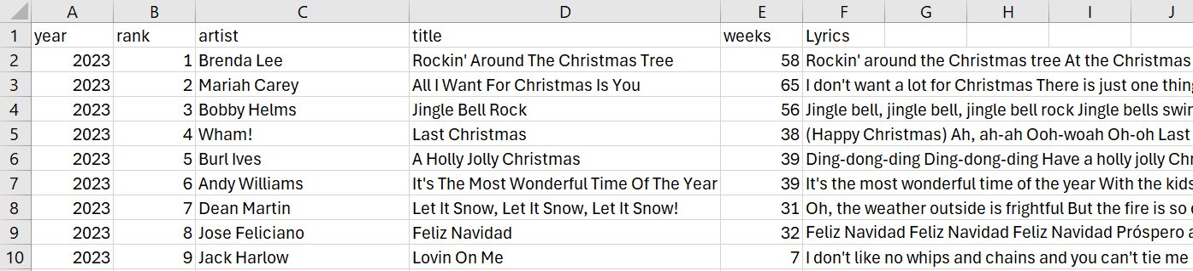
Data Snapshot

Slide 11
Data Preprocessing
Check for nulls – No null values in the data
Filter out records where the lyrics were marked ‘Not found’
Text cleaning – removed unnecessary characters like hyphens & parenthesis, removed line breaks and replaced with spaces, converted lyrics to lowercase, removed punctuations.
Clean Lyrics – Remove stop words like “a”, “an”, “the”, “at” and remove slang words.
Lemmatization – Reducing words to their base / dictionary form. For example, running becomes run using NLTK.
Count of unique words in each song lyric

Slide 12

Exploratory Data Analysis
Who were the most Popular Artists in the last 5 years?
What are the most frequently used words in song lyrics?
What were the most frequently used words by year?

Slide 13
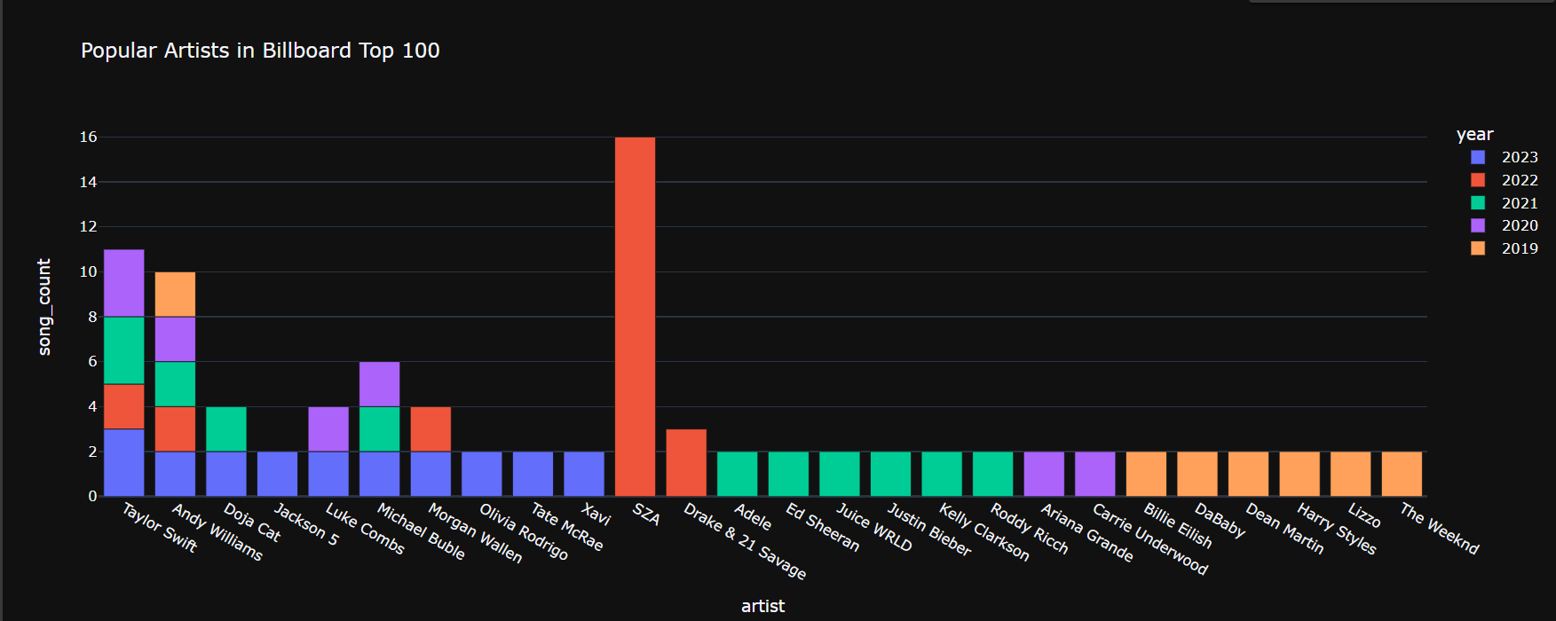


























SZA won 2022 with 16 songs in the Billboard Top 100

Slide 14
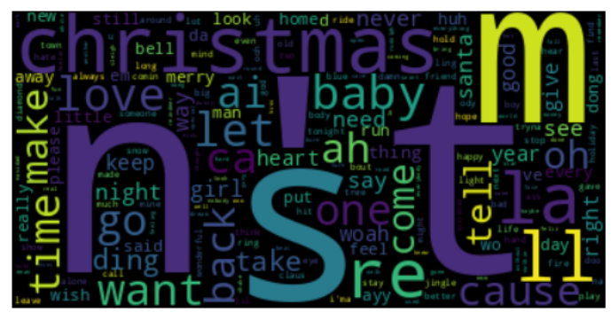
Christmas & Love are popular themes in songs

Slide 15
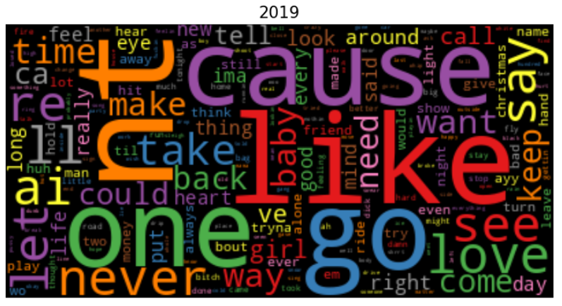
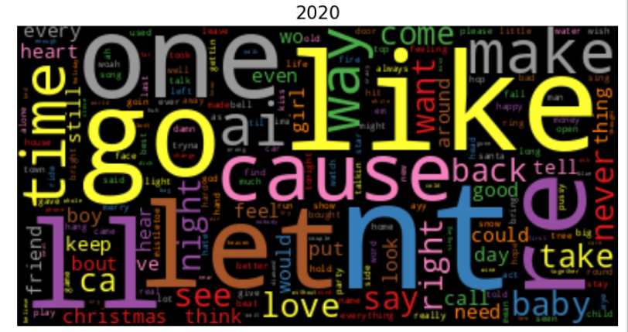
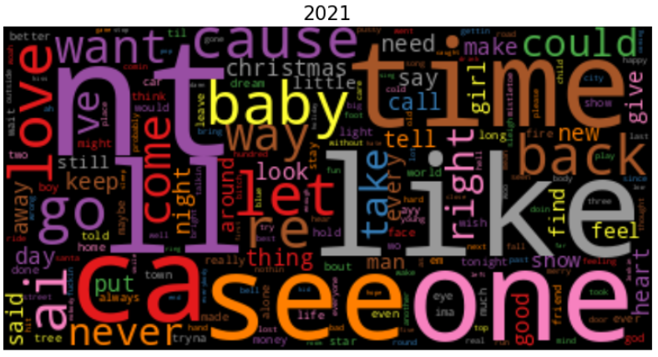
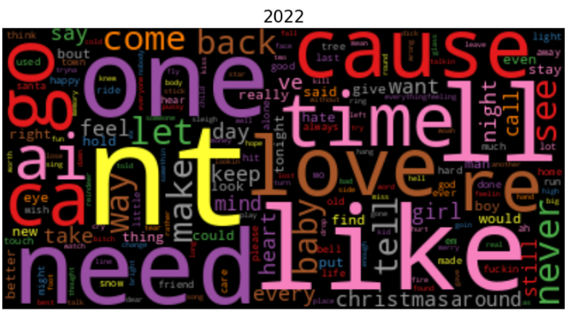
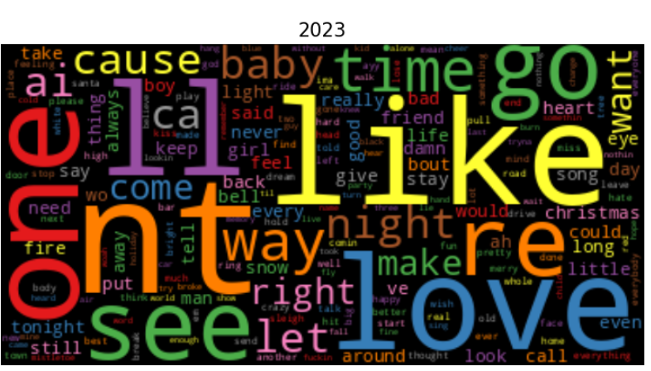
Like, love & need – most common themes over the years

Slide 16
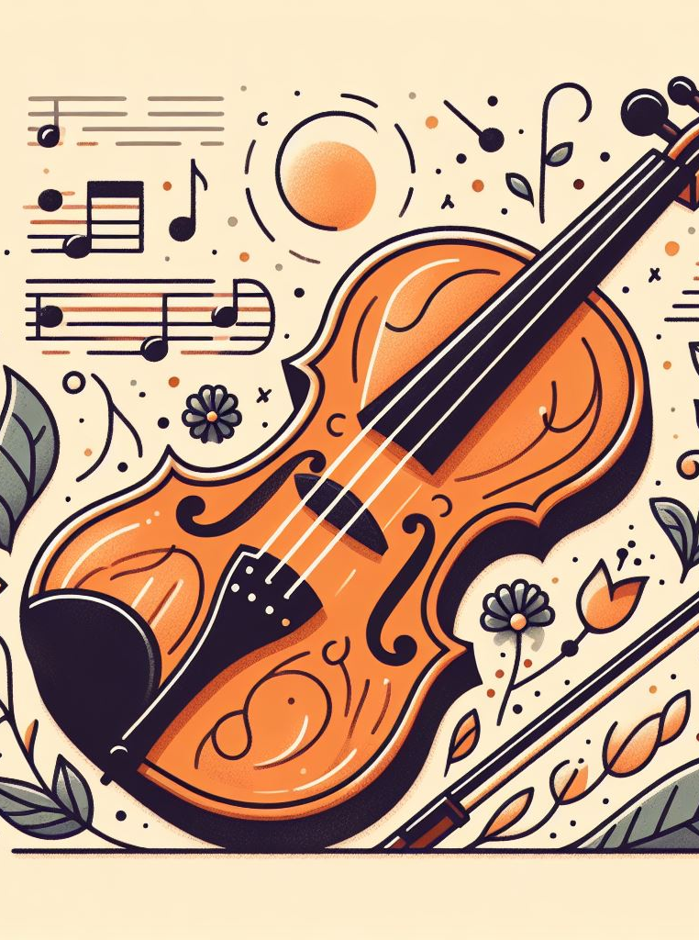
Sentiment Analysis
Methodology
Did COVID-19 see a lot of negativity in perception?
Count of songs on Top 100 each year and what was the sentiment?
Which artists had songs that had the most positive impact, and which were negative?
What are the words that are frequently used in positive, neutral, and negative sentiment songs?
Does sentiment influence the number of weeks a song stays in the Top 100?

Slide 17
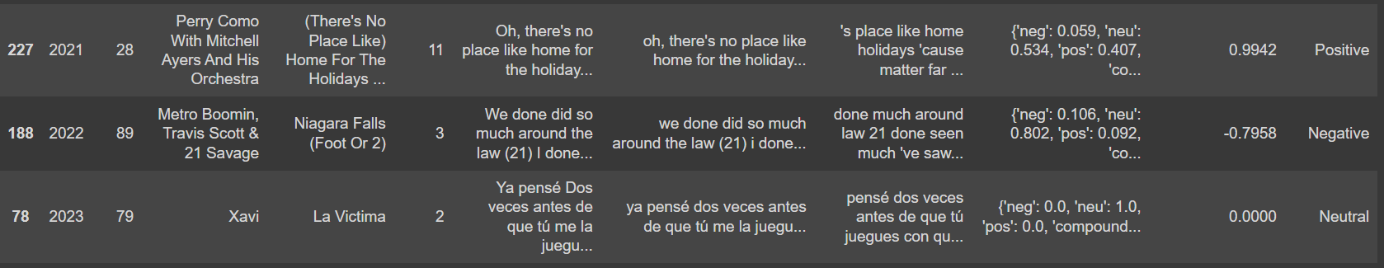
Methodology
NLTK library was used for the sentiment analysis.
SentimentIntensityAnalyzer() was used for modelling.
Sentiment scores were calculated for each of the songs which were then converted to compound scores.
The songs were classified as ‘Positive’ if compound_score >= 0.5, ‘Negative’ if compound_score <= -0.5 or else classified as ‘Neutral’.

Slide 18
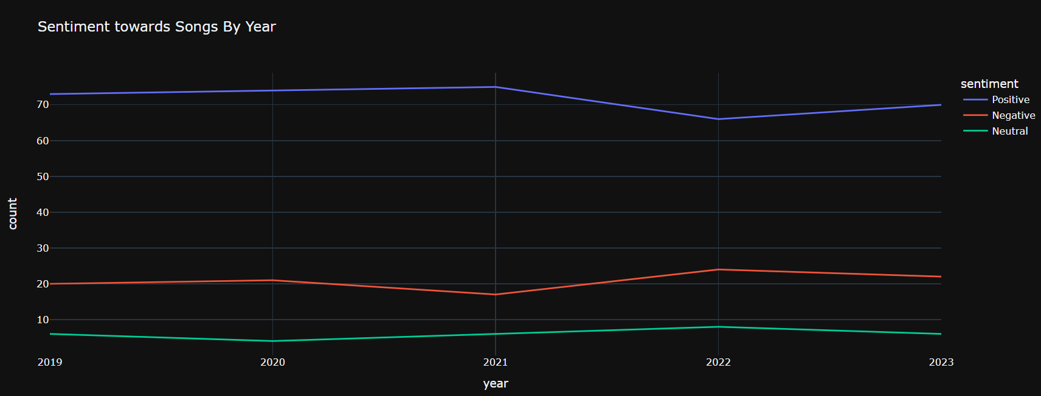
Positive sentiment was surprisingly the highest during the pandemic (2020-21) but dropped in 2022

Slide 19
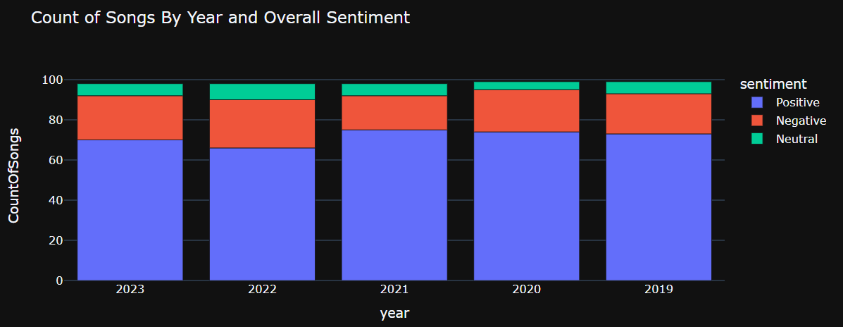
2022 was the least cheerful

Slide 20
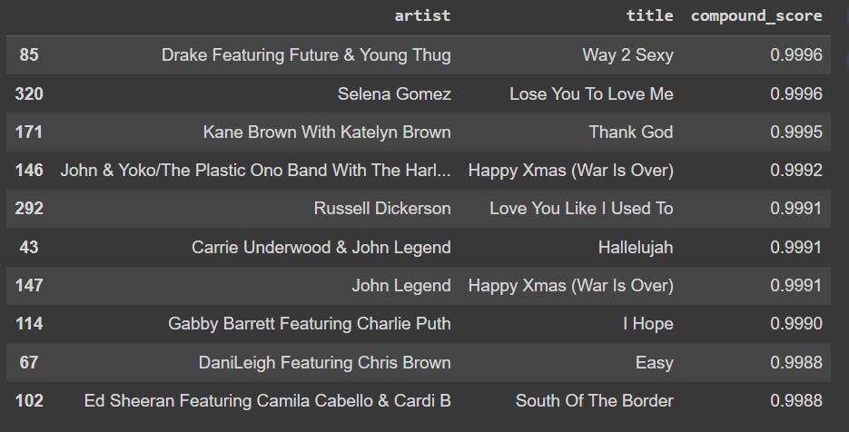
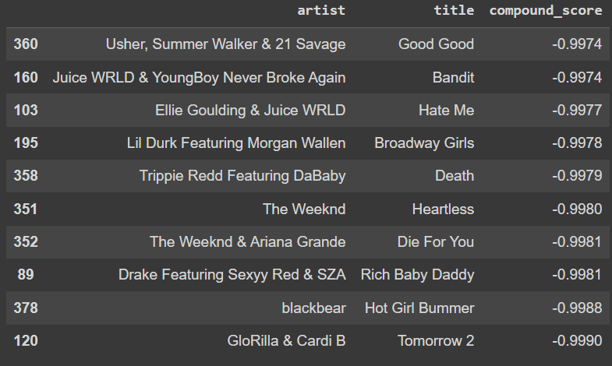
Drake feat. Future & Young Thug’s song has the most positive review whereas Usher, Summer Walker & 21 Savage’s song had the most negative sentiment score
Top 10 Positive Sentiment Songs
Top 10 Negative Sentiment Songs

Slide 21
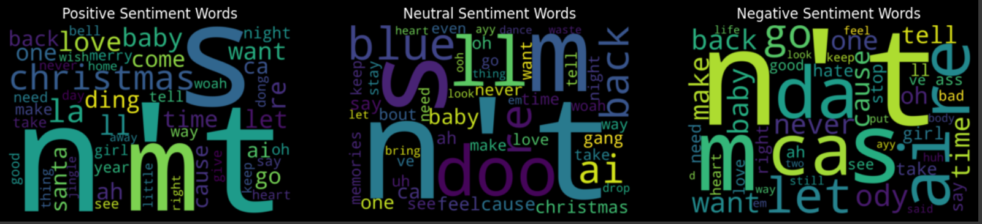
Words frequently used in songs under each sentiment

Slide 22
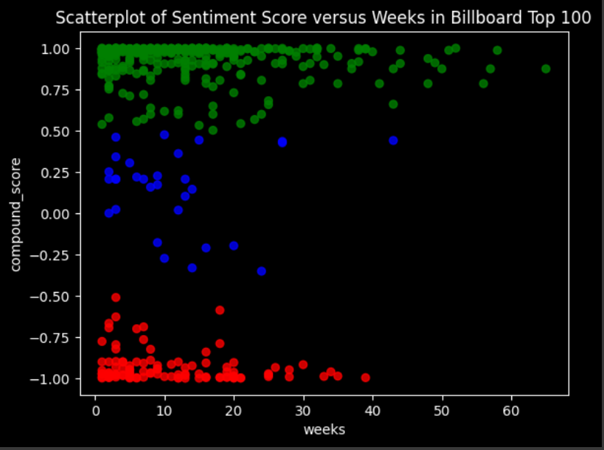
Positive songs tend to stay longer on the Billboard Top 100

Slide 23

Thank you!

